Slide 1


Bahirdar University Bahirdar Institute of Technology Faculty of Computing Department of Artificial Intelligence and Data Science
Natural Language Processing Presentation on
Text Summarization
By: Chalachew Mulu
To: Alemu K.(Assistance Prof.)
January 9, 2023
Bahirdar, Ethiopia
BIT

Slide 2


Outline
01
Introduction
02
What is Text Summarization
03
Why We Need
04
Types of Text Summarization
05
How It Works
06
Conclusion
07
Reference
08
Implementation Demo

Slide 3
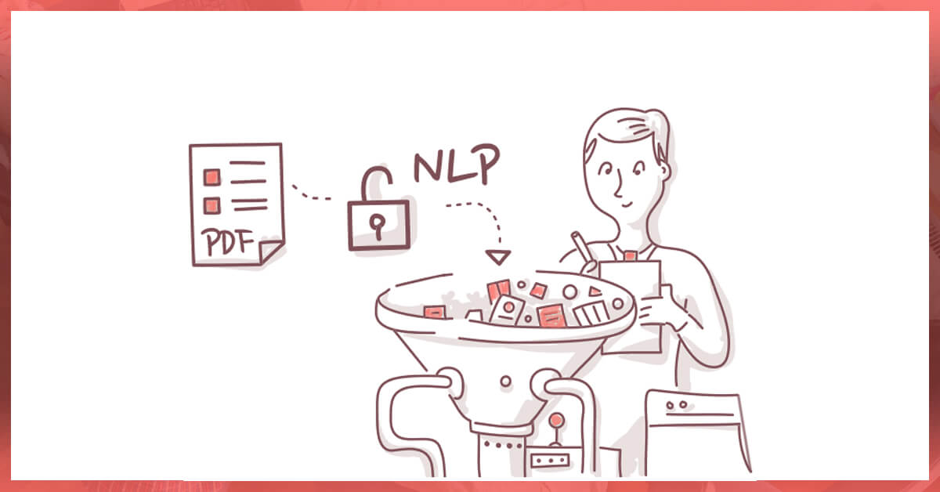
Introduction
It can take days or weeks to sift through a 50-page technical document. Filtering out irrelevant material, and writing a complete summary of the text without compromising on correctness is very important.
Text summarization refers to the technique of shortening long pieces of text.
This is why data science, AI, machine learning, and natural language processing (NLP) text summarization come in handy.

Slide 4
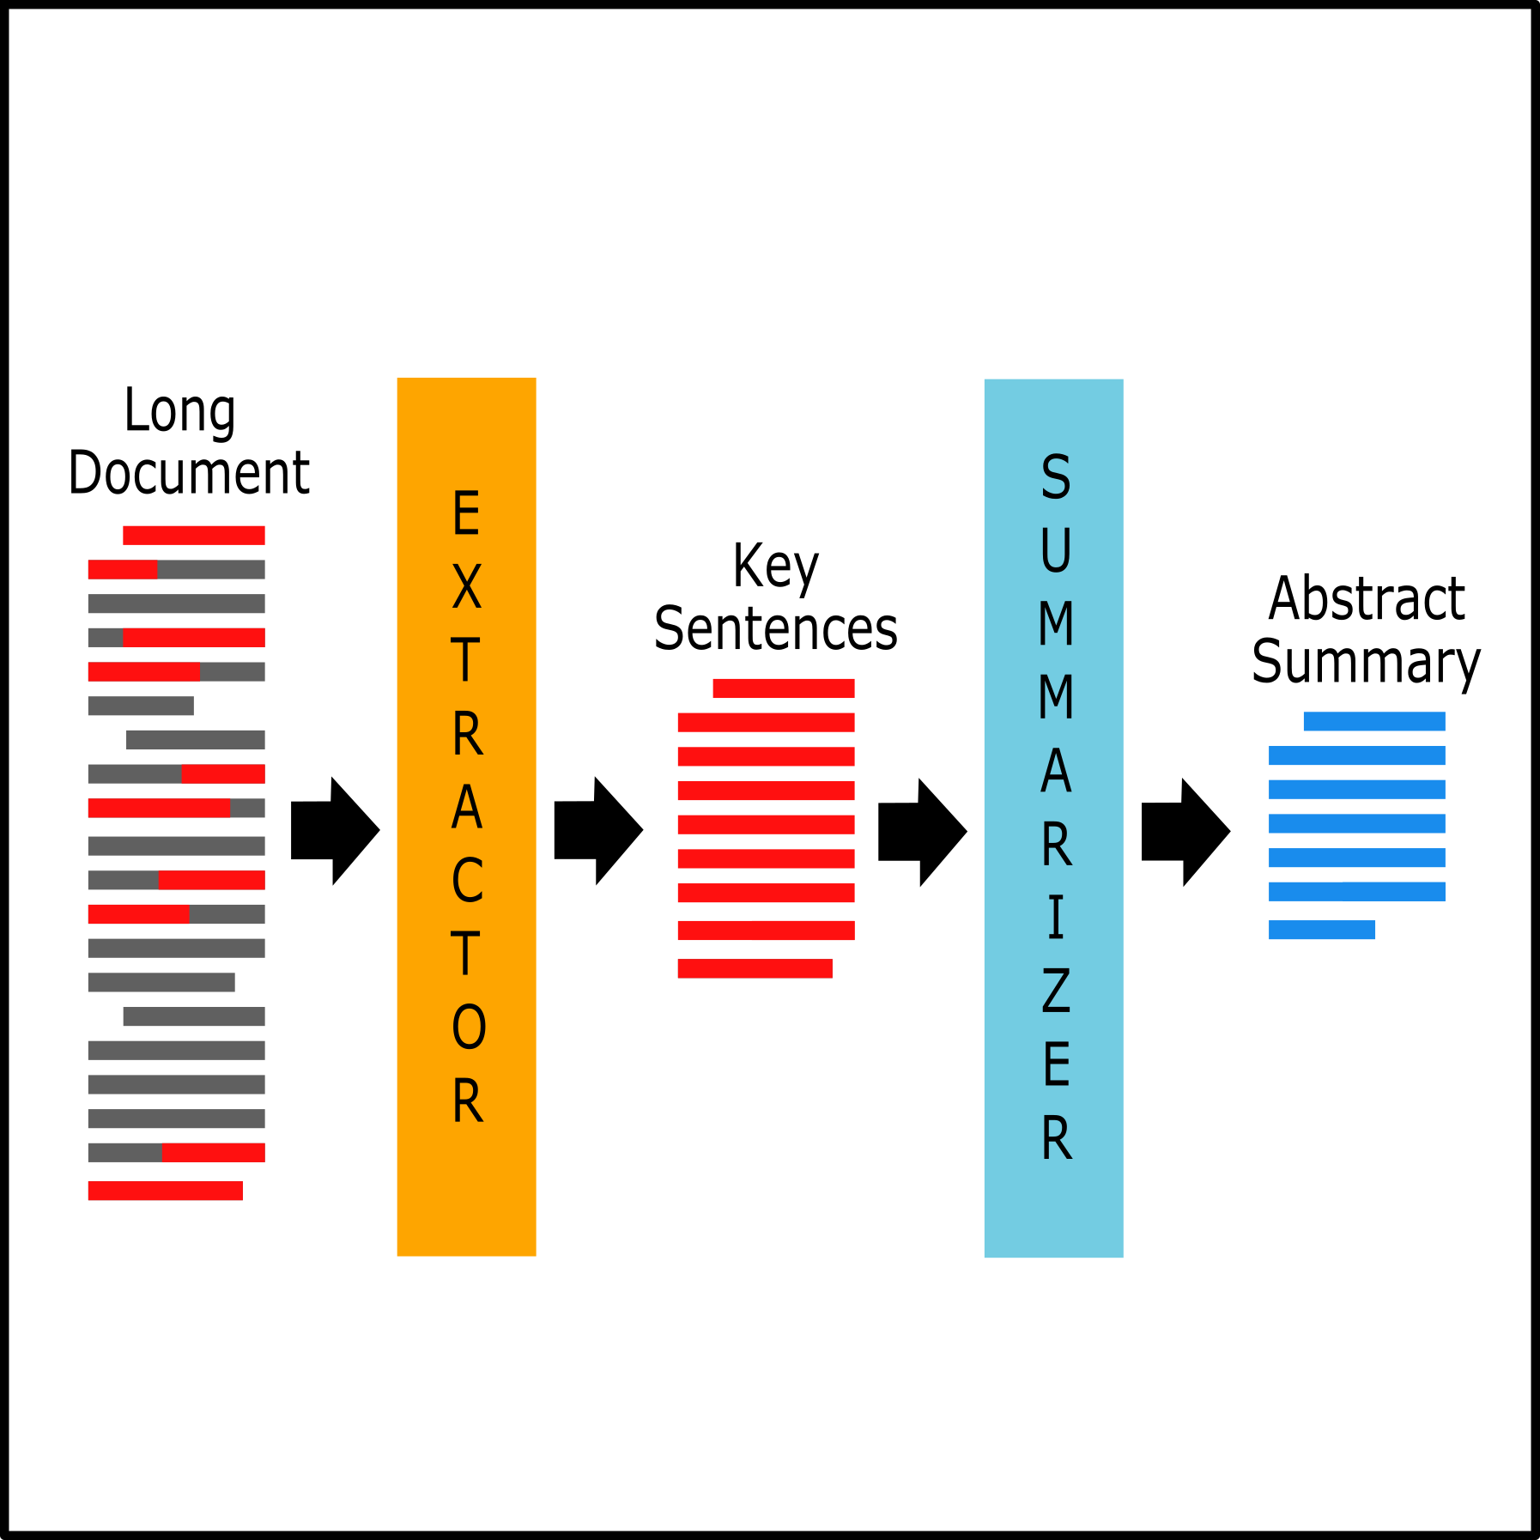

What is text summarization
NLP text summarization is the process of breaking down lengthy text into digestible paragraphs or sentences.
This method extracts vital information while also preserving the meaning of the text.

Slide 5

What is text summarization Cont…
Text summarization is the process of creating a concise, coherent, and fluent summary of a longer text document, which involves underlining the document’s key points.
This reduces the time required for grasping lengthy pieces such as articles without losing vital information.

Slide 6
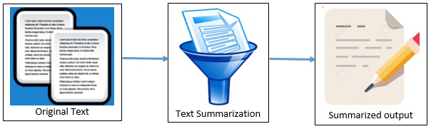
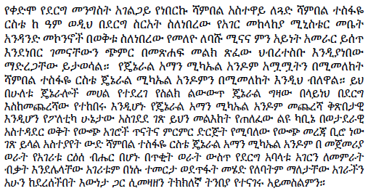
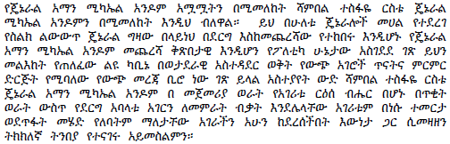
What is Text Summarization Cont…

Slide 7

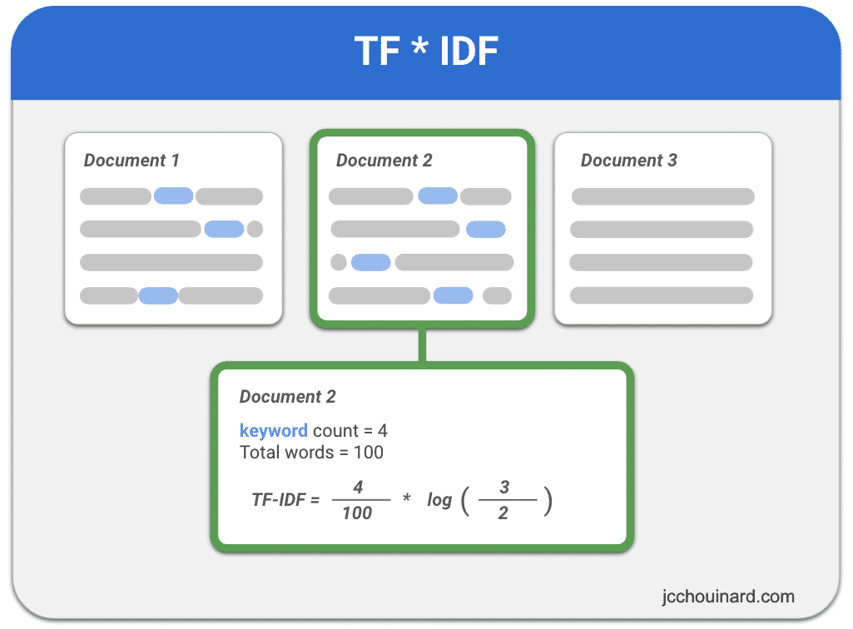
How it works
Example:
We have document
Only 2 contain a certain keyword
The keyword appears 4 times in a 100 words document.
Install and import library
Prepare corpus
Data Preprocessing
Text Cleaning
segmentation
Tokenization
Stop word removal
Feature extraction (TF-IDF)

Slide 8
How it works Con…
Sentence Segmentation
Converts raw text into sentences
List of strings
Sentence tokenizer
Example:
Input text: አበበ በሶ በላ። አለሙ ወደ በቱ ሄድ።
Output Seg1: አበበ በሶ በላ።
Output Seg2: አስቴር ትምህርት ቤት ሄደች።
Tokenization
Identifies the word tokens from a given sentence
Provides a list of tokens as output
Word tokenizer
Example
Input text: አበበ በሶ በላ።
Output text: [አበበ],[በሶ],[በላ]
Stop Word Removal: remove words that frequently appear in the document Example: ወደ

Slide 9
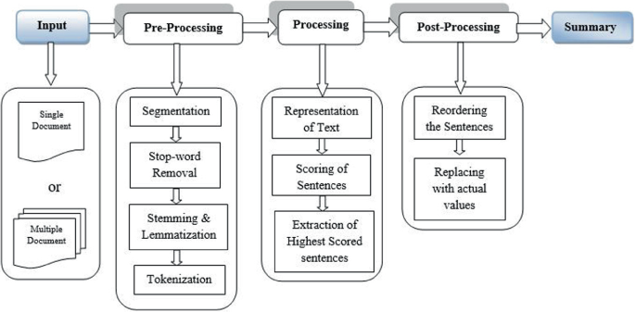
How it works Con…

Slide 10

Why Text Summarization?
Big Data. A lot of text data.
Accelerates the process of information retrieval.
Discover relevant information and consume faster.
Increases the amount of information that can fit in an area.
Expensive and time-consuming if done without machines.
Generating headlines for news and articles.
Outlines, such as notes for students.
Gmail is trying to implement a new feature to summarize all emails you received recently.

Slide 11
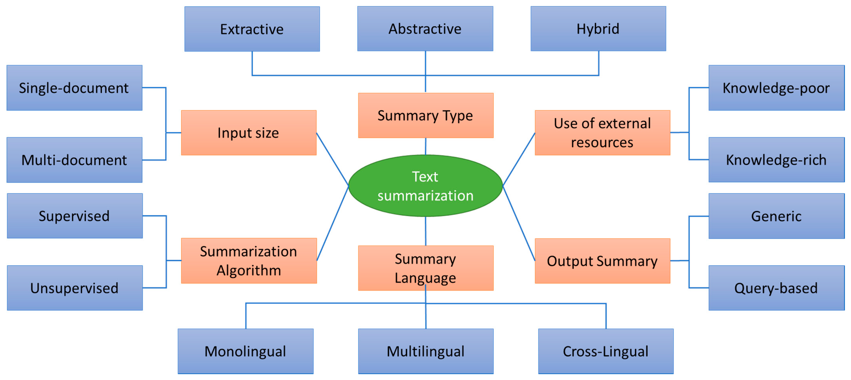
Types of Summarization

Slide 12
Application of Text Summarization
1
Media Monitoring
Text Summarization
2
Newsletter
3
Information Retrieval
4
Books an Litrature

Slide 13
Conclusion
Text Summarization has been shown to be useful for Natural Language Processing tasks such as Question Answering or Text Classification and other related fields of computer science such as Information Retrieval
And the access time for information searching will be improved.
Developing Amharic language abstractive-based summarization of text, audio, and video data is some of the hot research areas.

Slide 14
Reference
https://accern.com/blog/nlp-text-summarization/
https://towardsdatascience.com/a-quick-introduction-to-text-summarization-in-machine-learning-3d27ccf18a9f
https://www.topcoder.com/thrive/articles/text-summarization-in-nlp

Slide 15
</Code Demo>

